Slide 1


Microsoft Azure Machine Learning
Amy Nicholson
Technical Evangelist
Microsoft
Notes:
Hi! + Technical Evangelists in DX.
Agenda:
- Introduction into MAML and where does it sit in terms of our cloud services
- look a generic data science process model
- define a scenario used for our demo;
- short Demo: introducing the ML Studio

Slide 2
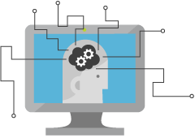
What is Machine Learning (ML)
Computing Systems that become smarter with Experience
Experience = Past Data + Human Input
Notes:
Machine Learning is a term that is not widely understood,
Some think it is artificial intelligence or robotics or any number of things.
It’s helpful to start with how Microsoft thinks of machine learning. Machine learning means computers that become smarter with experience. What do we mean by experience?
Experience is past data + human input. And that past data is often huge –
the quantity of data is doubling about every 18 months and that’s only increasing from here.
Computers can consider far more variables than a human making the same decision.
And what do we mean by human input? Human input takes two forms – the input of the user who is either communicating that the output is what they are looking to see or not. In the case that it’s not, the machine can either self-adjust to deliver better results moving forward or the advanced analytic developer or data scientist can make those changes to the model.

Slide 3






What is Machine Learning (ML)
Notes:
Envirohack event example, monitoring/predicting certain situations in the environment (jellyfish, climate, solar panel usage)
Predicting when things go wrong – predictive maintenance (Thyssen Krupp)
Bioscience (breast cancer etc.)
Retail – amazon shopping basket, recommendation engines etc.
Credit card fraud, banking, hedge funds
Natural user interfaces (HCI) skype translator, Kinect, sign language example

Slide 4



Why Now?
+
+
=
Notes:
So why now?
In the past many algorithms quite old, however had to be simplified to actually be usable, now this is no longer a problem and complex algorithms can be used. This is because of 3 factors
One, we can use the power of the cloud and borrow the compute power and storage from there
Agility/ease of use – rapidly prototyping, Being able to train these models in a shorter amount of time
And the easily available data to sufficiently train these models. Connected devices
This has allowed for machine learning to be operationalized and available to everyone to produce intelligent applications

Slide 5
What is Azure Machine Learning
Data
Clients
API
ML STUDIO
Model is now a web service that is callable
Blobs and Tables
Hadoop (HDInsight)
Relational DB (Azure SQL DB)
Integrated development environment for Machine Learning
Monetize the API through our marketplace
Notes:
The elegance of the solution is in its simplicity – something that has been lacking in the machine learning space
The first issue many enterprises face is data ingestion. With the cloud, you can bring in data sources with the ease of a drop down or drop your on-premises data set into the built in storage space. Users can then model in our development environment – Machine Learning Studio
where we’re offering R, Python and SQLite as first class citizens in addition to our world-class Microsoft algorithms.
The second issue – and often the primary one – is putting finished work into production in a way others can use. Client devices, websites, mobile applications, excel spreadsheets you name it anything that supports HTTP requests.
We’ve heard from many data scientists that they model in R on a Linux stack but then have to hand over their work to developers who need to translate that into another language to actually make it work.
This time consuming and unnecessary process has been eliminated with our system, as the model is with a click transformed into a web service end-point that can run over any data, anywhere and connect to any solution or client.
Next, not only can this model be put into production for your company, it can be made available for the world on our Machine Learning Marketplace. Microsoft hosts your solution and markets it for you, while you have the freedom to brand and monetize as you see fit.

Slide 6
Azure ML Studio Demo
Digit Recognition Demo
Full Tutorial Document available here: http://1drv.ms/1CjzW2f
Video of Demo: http://1drv.ms/1Qr2X6M
Notes:
Browser: www.azure.microsoft.com
Document: http://1drv.ms/1CjzW2f

Slide 7
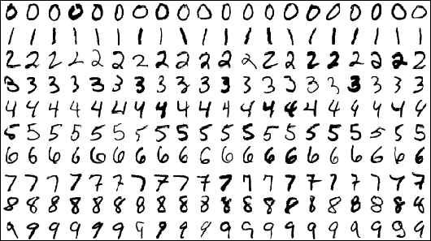
Our Scenario
Using the popular MNIST Dataset – used widely in the Machine Learning Community for testing Image Processing Systems
42,000 images used – each image 28 x 28 pixels with a represented pixel value between 0 – 255
Data in CSV file – 785 columns in total = 1 label and 784 pixel values per image
Notes:
Aim: to show the power of prediction through Azure ML in very little time and in-depth knowledge needed
Whole process -> creation to publishing a model as a web service in a short period of time
Objective: will a flight be delayed or not given some flight and weather details
Two datasets will be needed and joined
Scenario = form of supervised learning
We have previous data and the label or considered correct answer we can train our model on
Also a binary classification problem
Historical data to predict flight delayed or not
Yes or no / 1 or 0
Finally a web service will be produced that we can query with flight and weather data to gain a prediction

Slide 8
Machine Learning API’s
Announced at //Build - #ProjectOxford
Notes:
Machine Learning APIs now available in the Microsoft Azure Machine Learning Gallery
These API are powerful tools/APIs and SDKs that can help you create very intelligent applications
Some of these APIs were announced at //BUILD at the end of last month so lets take a look at an example of these APIs in action

Slide 9
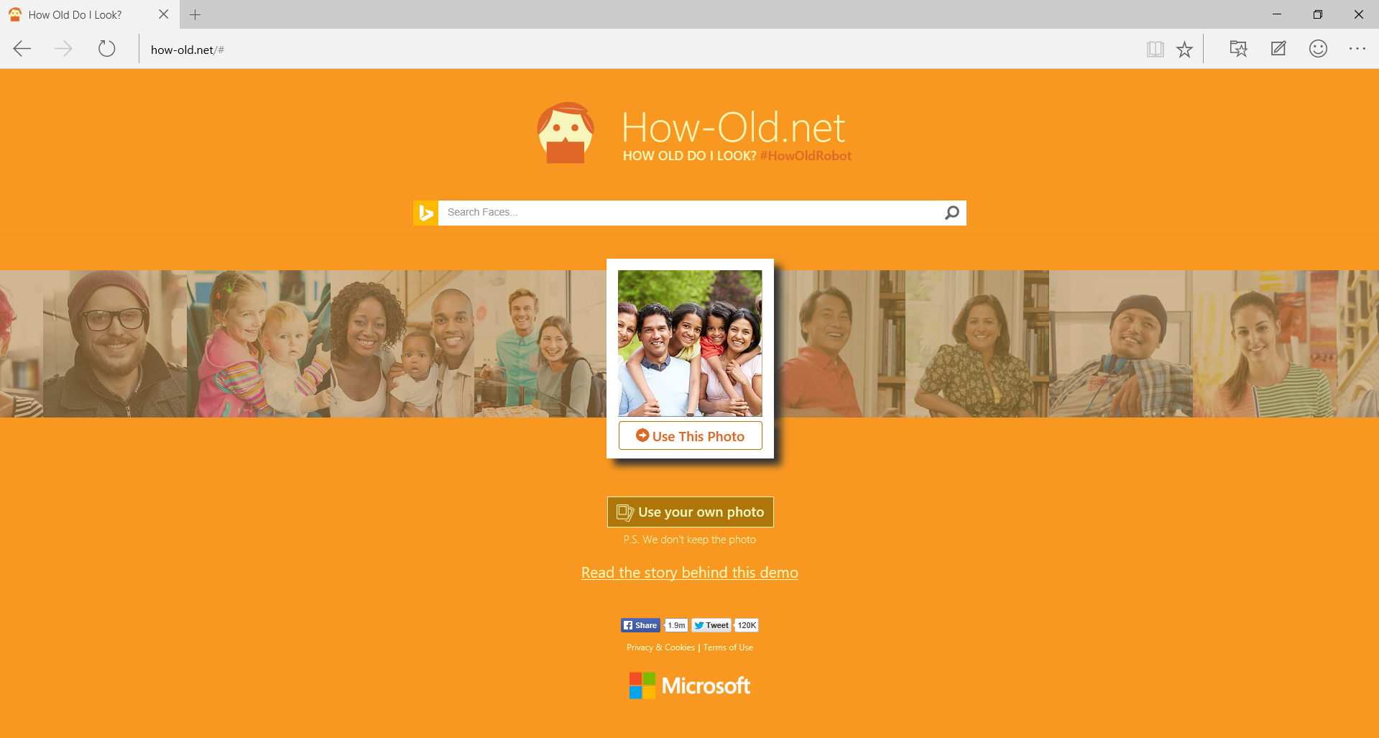
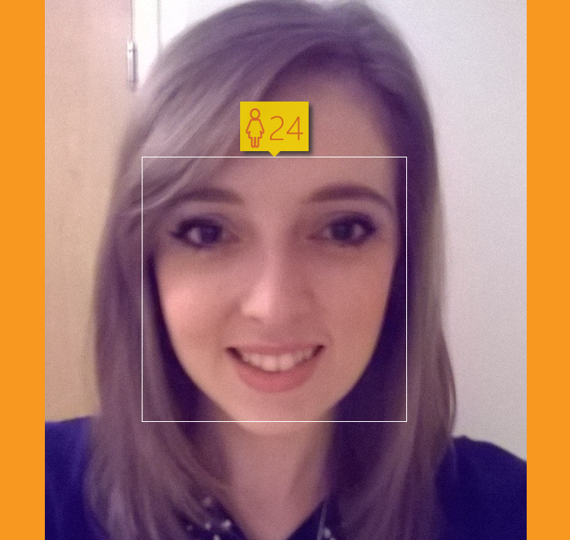
Notes:
How-old.net
Day 2 Keynote at the //BUILD developer conference
the site went viral on social media – something like 300 million image have been uploaded and analysed on the site
This site allows you to enter a picture of a person and it will estimate your gender and age, so I tried it out
Although lots of people got varying results it actually predicted very well for me. I am female and I am actually 24 in December, so not too bad!
Now the functionality behind this app includes many of the data services we mentioned on the previous slides, stream analytics, power BI and also …

Slide 10
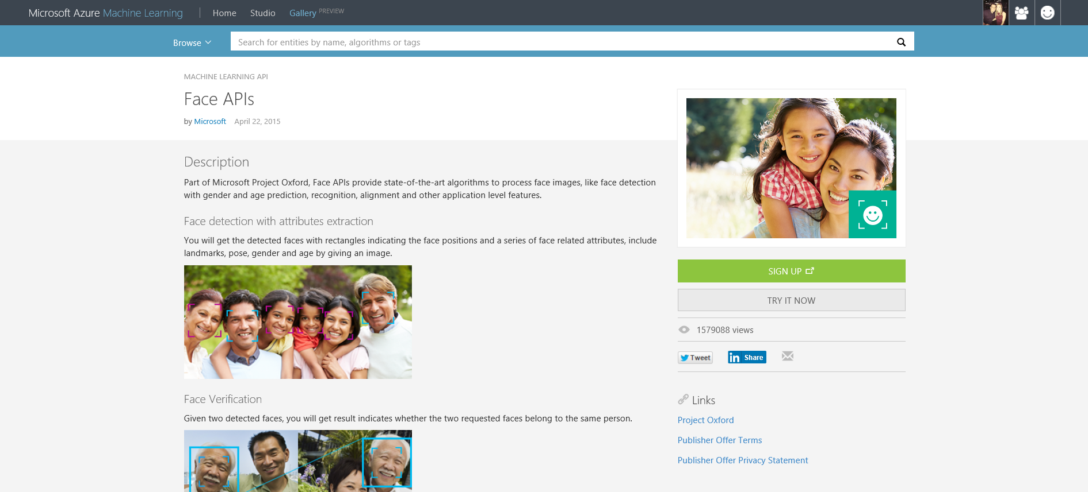
Machine Learning APIs
Notes:
The Face API available in the Azure Machine Learning Gallery
Originally code named Project Oxford, Microsoft have released a variety of APIs such as Face Detection, Language Understanding Services, speech recognition etc.
I want to show you very quickly some of the functionality of the Face API and how easy it is so sign up for … DEMO

Slide 11
A Helpful Resource
Azure Machine Learning Classifier Cheat Sheet:
Notes:
Machine Learning APIs now available in the Microsoft Azure Machine Learning Gallery
These API are powerful tools/APIs and SDKs that can help you create very intelligent applications
Some of these APIs were announced at //BUILD at the end of last month so lets take a look at an example of these APIs in action

Slide 12
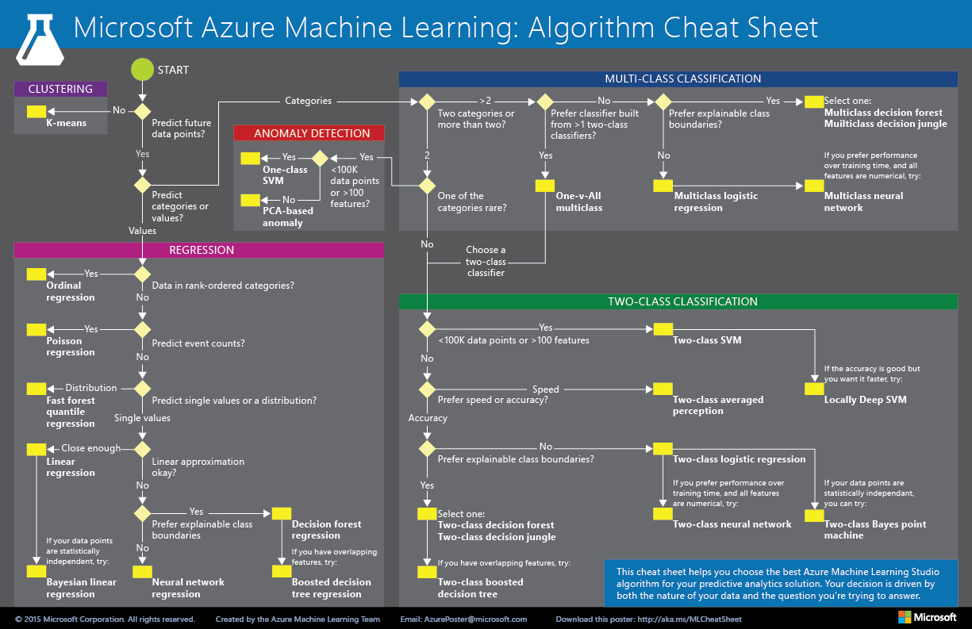
Azure ML Cheat Sheet
http://1drv.ms/1CjzW2f
Notes:
Aim: to show the power of prediction through Azure ML in very little time and in-depth knowledge needed
Whole process -> creation to publishing a model as a web service in a short period of time
Objective: will a flight be delayed or not given some flight and weather details
Two datasets will be needed and joined
Scenario = form of supervised learning
We have previous data and the label or considered correct answer we can train our model on
Also a binary classification problem
Historical data to predict flight delayed or not
Yes or no / 1 or 0
Finally a web service will be produced that we can query with flight and weather data to gain a prediction

Slide 13

Next Steps
Explore the other Data Services available on Azure
Find Azure ML Tutorials Available in the Gallery
Use Azure ML to Predict a Scenario Relevant to you!
Notes:
So my recommended next steps for you guys is to
Explore the other data services mentioned that are available on Azure, remember machine learning may only be one part of an end to end scenario
To get deeper in the Azure ML studio use the provided lab guide (will show details on next slide) and also check out some of the experiments people have already created in the gallery
Finally think of the CRISP-DM model, the best starting point is to think of scenarios where machine learning can help you enhance an application, a service, a business process etc.

Slide 14



Thanks for your time
Amy Nicholson
Useful Links:
http://azure.microsoft.com/ - sign up for your trial
https://studio.azureml.net/ - log into the studio
https://gallery.azureml.net/ - check out the gallery
http://1drv.ms/1CjzW2f - download the lab guide
@AmyKateNicho
Andrew Fryer
@DeepFat
Notes:
Thank you for your time and here are some useful links to help you get started

